Slide 1
Online Sales Analysis using SQL
By Prachi Khartade

Slide 2
Project Objective
The primary objective of this project is to analyze the sales data across different branches, cities, and customer demographics to derive insights into sales performance. Specifically, the project aims to:
Identify trends in product line sales based on customer type and gender.
Assess the impact of different payment methods on overall sales.
Analyze the correlation between customer ratings and sales figures.
Calculate and evaluate key performance indicators (KPIs) such as gross income, gross margin percentage, and VAT impact.

Slide 3
Expected Outcome
Business Insights:
Identified key drivers of sales.
Recommendations for marketing strategies based on high-performing segments.
Strategic Decision-Making:
Suggestions on where to allocate resources and focus marketing efforts.
Improved Reporting:
Data-driven insights for stakeholders to make informed decisions.

Slide 4

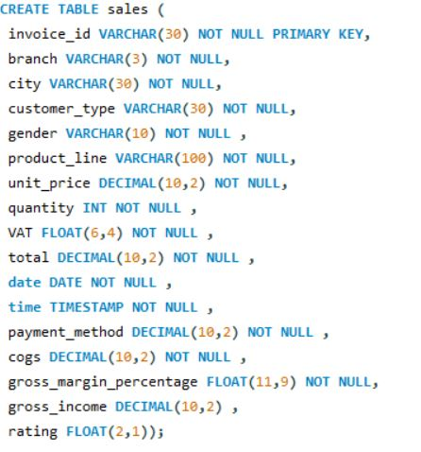
Creating Database and Table and import Data
Create database and table
The first step is to create a database where all the data will be stored. In SQL, this is done using the CREATE DATABASE
command followed by the name of the database. After creating the database, we need create table and insert the data using CREATE and INSERT INTO command

Slide 5
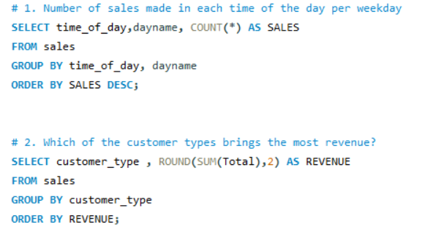
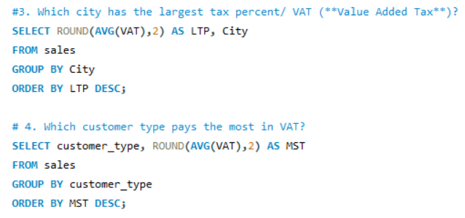
1. SALES ANALYSIS
Developed and optimized SQL queries to perform comprehensive sales analysis, including daily sales trends, branch performance, and identification of top-selling days.

Slide 6
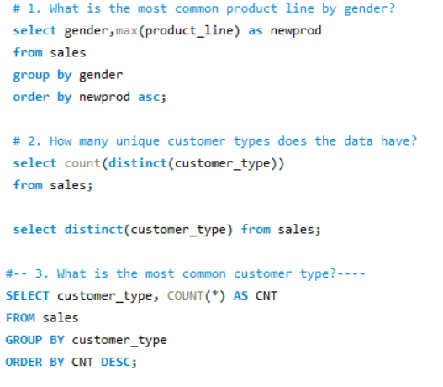
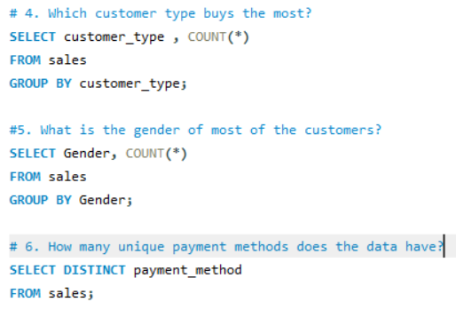
2.CUSTOMER ANALYSIS
Analyzed customer segments through SQL queries, focusing on gender-based purchasing behavior and customer type contributions, which informed targeted marketing strategies.

Slide 7
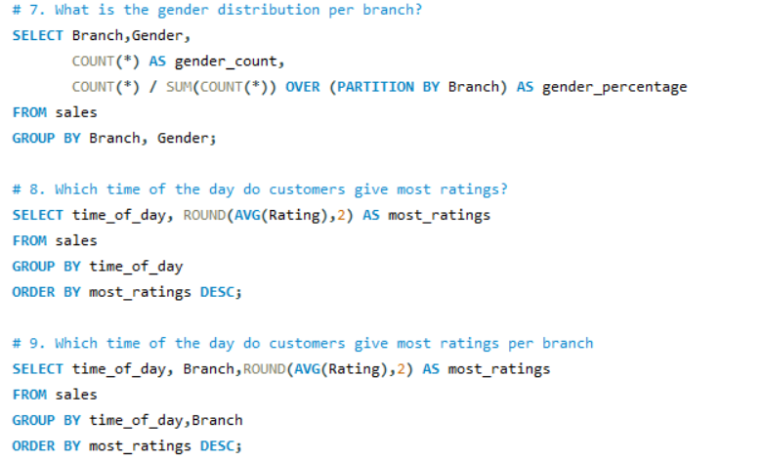
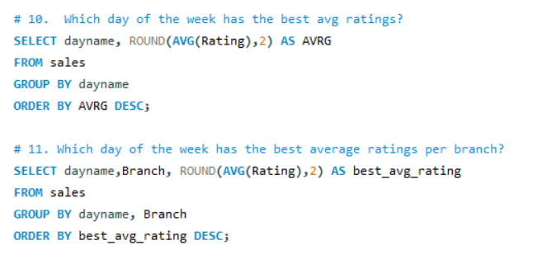

Slide 8
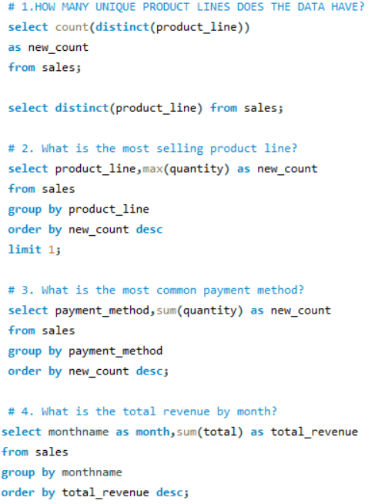
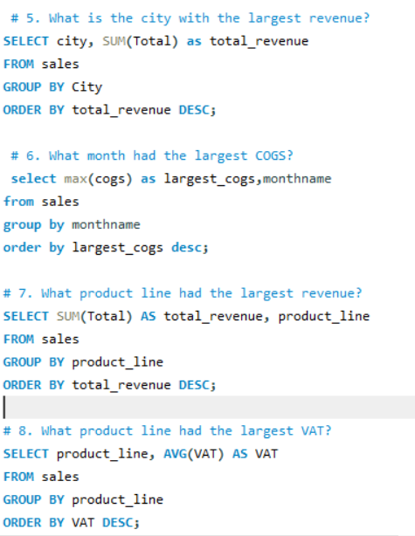
3.PRODUCTS ANALYSIS
Evaluated product line performance through SQL-based analysis, identifying high-revenue products and calculating gross income and profitability margins.

Slide 9
Conclusion
The insights derived from this analysis can directly inform business strategies.
For instance, enhancing product availability in top-performing branches or focusing marketing efforts on female customers and specific product lines, can drive further growth.
Understanding customer preferences at a granular level enables the business to tailor its offerings improving customer satisfaction and increasing sales.
The findings from this analysis can serve as a foundation for more advanced studies.
For example, examining seasonal trends, customer loyalty and the impact of discounts or promotions could further refine our understanding of what drives sales in different segments.

Slide 10
THANK YOU

